Slide 1

RV College of Engineering
Go, change the world
Experiential Learning Phase 1: Presentation
Topic: WATER QUALITY MONITORING SYSTEM
SUBJECT | Environmental Sustainability
BRANCH | CSE

Slide 2

TEAM INTRODUCTION
RV College of Engineering
Go, Change the World
Admission No. | Name | Email Id
RVCE23BCS414 | NAGAPRASAD NAIK | nagaprasadnaik.cs23@rvce.edu.in
RVCE23BCS404 | VIKAS J | vikasj.cs23@rvce.edu.in
RVCE23BCS409 | MANOJ KUMAR B V | manojkumarbv.cs23@rvce.edu.in
RVCE23BCS40 | UJJWAL | ujjwalsg.cs23@rvce.edu.in

Slide 3

Presentation Outline
RV College of
_{Engineering} Go, Change the World
RV College of Engineering®
Go, change Ǧhe world
Table of Contents
INTRODUCTION
ABSTRACT AND OBJECTIVES
LITERATURE SURVEY
HARDWARE AND SOFTWARE COMPONENTS USED
WORKING OF PRODUCTS
SOFTWARE BLOCK DIAGRAM
KEY FEATURES
FUTURE SCOPE
REFERENCE

Slide 4
Literature survey
RV College of Engineering
Go, Change the World
Publisher: IEEE (ThingSpeak)
Mohd Amirul Asyraf Razali; Murizah Kassim; Norakmar Arbain Sulaiman; Shuria Saaidin
Water monitoring and analytic based ThingSpeak
International Journal of Electrical and Computer Engineering (IJECE)
Water Quality Monitoring System Based on IOT Vaishnavi V. Daigavane and Dr. M.A Gaikwad
Nikhil Kedia entitled “Water Quality Monitoring for Rural Areas-A Sensor Cloud Based Economical Project.” Published in 2015 1st International Conference on Next Generation Computing Technologies (NGCT-2015) Dehradun, India : This paper highlights the entire water quality monitoring methods, sensors, embedded design, and information dissipation procedure.

Slide 5
Abstract and objectives
RV College of Engineering
Go, Change the World
This presents a low-cost, real-time water quality monitoring system utilizing the ESP32 WiFi module, an analog Total Dissolved Solids (TDS) sensor, and a DS18B20 temperature sensor integrated with the ThingSpeak API for data storage and visualization.
The system measures key water quality parameters like TDS and temperature, providing valuable insights into potential contamination and ensuring efficient water management.
The proposed system offers advantages like affordability, remote monitoring capabilities, and scalability, making it suitable for various applications, including aquaculture, hydroponics, and environmental monitoring.

Slide 6
Introduction
RV College of
_{Engineering} Go, Change the World
RV College of Engineering®
Go, change Ǧhe world
Ensuring clean water availability is crucial for human health and ecosystem sustainability. However, water pollution and scarcity pose significant challenges worldwide. Traditional water quality monitoring methods often involve manual sample collection and laboratory analysis, leading to delays and resource limitations. Recent advancements in Internet of Things (IoT) technologies offer promising solutions for real-time, cost-effective water quality monitoring. system design, implementation details, and experimental results demonstrating its effectiveness in monitoring water quality parameters.

Slide 7
Hardware and software components used
RV College of Engineering
Go, Change the World
HARDWARE COMPONENTS :
ESP32 WiFi module: Acts as the central processing unit, collecting sensor data and transmitting it to the cloud platform.
Analog TDS sensor: Measures the total dissolved solids content in water, indicating potential contaminants.
DS18B20 temperature sensor: Measures water temperature, which is crucial for accurate TDS interpretation and potential biological activity monitoring.
Power supply: Battery provides power to the system, enabling deployment in remote locations.
Connectivity: WiFi module enables data transmission to the ThingSpeak cloud platform.
SOFTWARE :
Arduino IDE: Used to program the ESP32 module for data acquisition, processing, and communication.
ThingSpeak API: Provides data storage, visualization, and analysis tools.

Slide 8
Working Of Product
RV College of Engineering
Go, Change the World
Operation
Sensors continuously measure TDS and temperature values.
ESP32 collects sensor data at regular intervals.
Processed data is transmitted wirelessly to the ThingSpeak platform using HTTP POST requests.
ThingSpeak stores and visualizes the data in real-time dashboards and charts
Implementation
The system is implemented using an ESP32, an analog TDS sensor module, and a DS18B20 temperature sensor. The Arduino IDE is used to program the ESP32 with data acquisition, processing, and communication functionalities. The ThingSpeak API is utilized For data storage and visualization. Experimental testing is conducted to evaluate the System's accuracy and reliability in measuring TDS and temperature in various water samples.

Slide 9
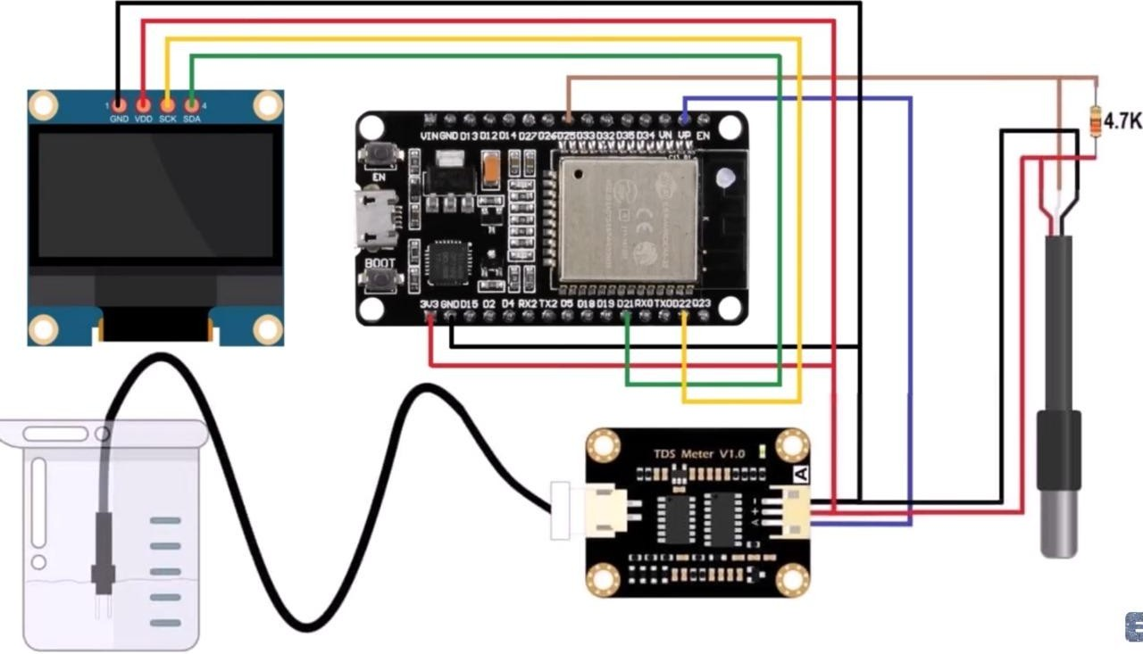
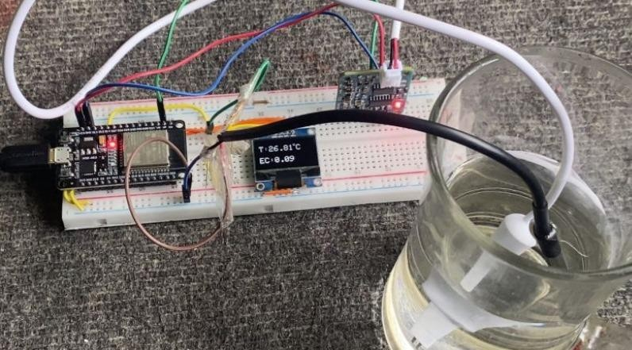
Block diagram
RV College of Engineering
Go, Change the World

Slide 10
Key Features
RV College of Engineering
Go, Change the World
Real-time Monitoring: Provides continuous insights into water quality, enabling prompt response to contamination events.
Cost-effective: Utilizes readily available and affordable components.
Scalability: The system can be easily expanded to monitor multiple water bodies or incorporate additional sensors.
Multi-Sensor Integration: Incorporate TDS and temperature sensors to gather comprehensive water quality data.
ThingSpeak Integration: Use ThingSpeak API to store, analyze, and visualize sensor data in the cloud, providing easy access to historical records.

Slide 11
Future Scope
RV College of Engineering
Go, Change the World
Integrate additional sensors: Consider adding pH sensors, turbidity sensors, or dissolved oxygen sensors for a comprehensive water quality analysis.
Enhance IoT features: Implement data logging, real-time monitoring, and remote access to improve the system's connectivity and accessibility.
User interface improvement: Develop a user-friendly interface for data visualization and analysis to make it more accessible and user-friendly.
Explore machine learning: Incorporate machine learning algorithms for predictive analytics, enabling your system to offer insights and predictions based on historical data.

Slide 12
References
RV College of Engineering
Go, Change the World
. J. Babu, V. N. Naik, and M. S. Babu, "IOT based water quality monitoring system," in 2016 International Conference on Circuit, Power and Computation (CCP), pp. 1-5, 2016.
. S. R. Yerralla, K. V. S. N. Raju, and P. V. S. N. Raju, "An arduino based water quality monitoring system using pH, temperature, turbidity and TDS sensors," in 2017 International Conference on Computer Communication and Informatics (ICCCI), pp. 1-6, 2017.
. L.-C. Yen, C.-Y. Wu, Y.-F. Chen, M.-H. Lin, and Y.-J. Hsu, "An AI-based water quality monitoring system using the internet of things (IoT)," in 2020 IEEE International Conference on Applied System Innovation (ICASI), pp. 1-4, 2020.

Slide 13
RV College of Engineering
Go, Change the World
Thank You

